Slide 1
Model Lifecycle
Pablo Maldonado

Slide 2
Motivation
Vision of AutoML: to help businesses people with limited ML knowledge and expertise build their own custom ML models.
Model development is, more often than not, NOT a one-off task:
Behavioral changes ➔ produced by the model or by externalities.
New data sources.
Software/platform updates.

Slide 3
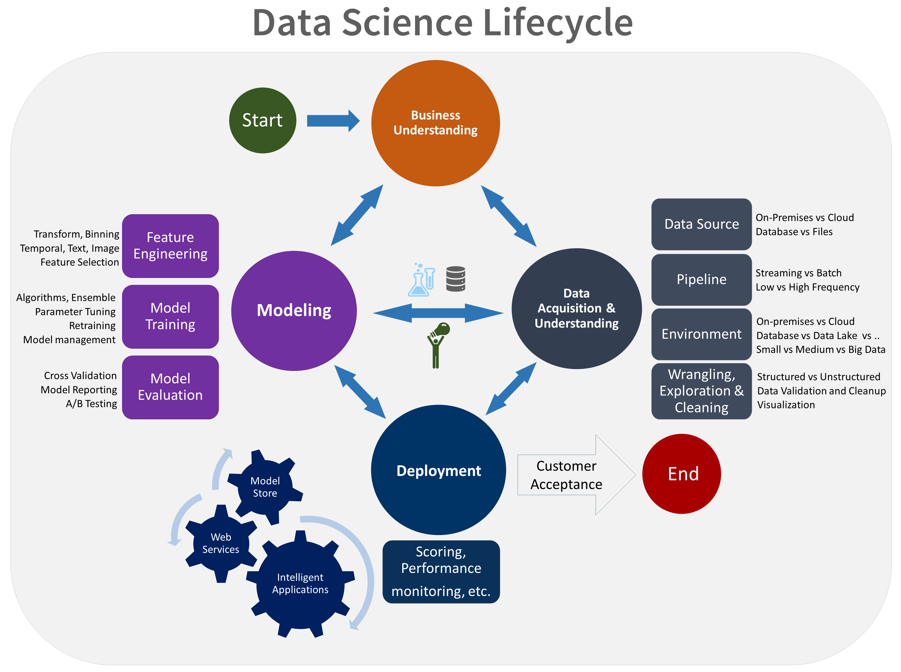
Data Science Lifecycle
https://docs.microsoft.com/en-us/azure/machine-learning/team-data-science-process/overview

Slide 4
Model Lifecycle
Data Ingestion
Data Discovery
Feature Engineering
Model Development
Model Scoring
Model Deployment
New data collected!

Slide 5
ML in Production
Train: one-off, batch and real-time/online training
Serve:
Batch
Real-time
Database Trigger
Web service (REST API)
In-app / Embedded

Slide 6
One-off training
Ad-hoc training by a data scientist.
Model can be refreshed every 3-6 months.
Workflow:
Run an ETL job to get train/test data.
Score new data after model is refreshed (usually model parameters only).
Typical example: Churn/credit risk models.

Slide 7
Saving one-off trained models
Pickle/cPickle/joblib
Not portable across programming languages, some issues across platforms.
ONNX
Open Neural Network Exchange format.
PMML
Predictive Model Markup Language. Around since 1997, supported by SAP.
POJO/MOJO
Export directly Java objects from H2O
POJOs are older and are size-restricted. Found to be around 10% faster for binomial and regression models, but 50% slower for multinomial.
http://docs.h2o.ai/h2o/latest-stable/h2o-docs/productionizing.html

Slide 8
Batch Training
All data is trained at once.
Might be not a one-off task, but could be even scheduled as a daily job.
AutoML frameworks can be very useful here:
Thanks to hyperparameter optimization subroutines, the model can squeeze more juice out of the data, faster than any data scientist could.
Typical example: advertising, retargeting.

Slide 9
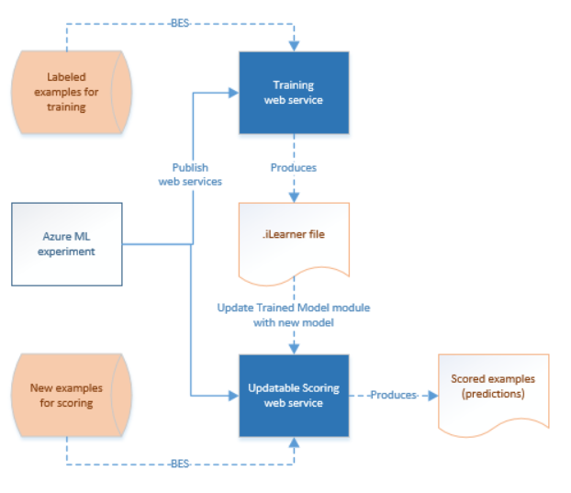
Example: Azure Data Factory
Create your experiment in Azure ML Studio.
When you are satisfied with your model, use Azure ML Studio to publish web services for both the training experiment and the scoring experiment.
The scoring web service endpoint is used to make predictions about new data examples. The output of prediction could have various forms, such as a .csv file or rows in Azure SQL databases, depending on the configuration of the experiment.
The training web service is used to generate new, trained models from new training data. The output of retraining is a .ilearner file in Azure Blob storage.
https://azure.microsoft.com/es-es/blog/retraining-and-updating-azure-machine-learning-models-with-azure-data-factory/

Slide 10
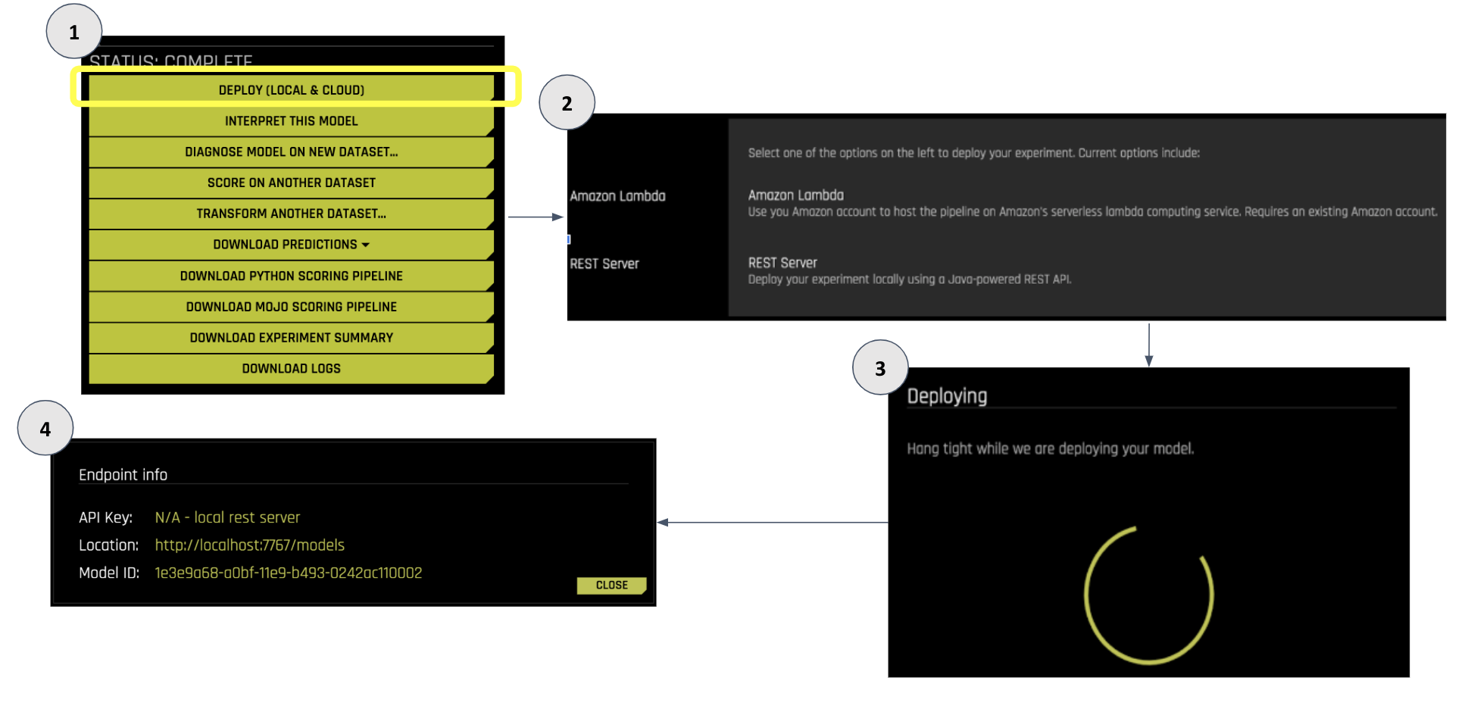
Example: Driverless AI

Slide 11
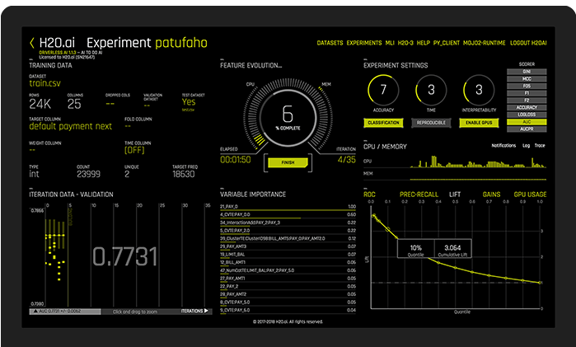
Example: Driverless AI
https://www.h2o.ai/products/h2o-driverless-ai/model-deployment/

Slide 12
Real-Time Training
More challenging: noise/outliers can derail the model behavior.
Sometimes no other option (e.g. if data cannot be stored).
Algorithms need to support this method of training:
Mini-batch K-Means.
Linear/Logistic Regression (with stochastic gradient descent).
Naïve Bayes Classifier.

Slide 13
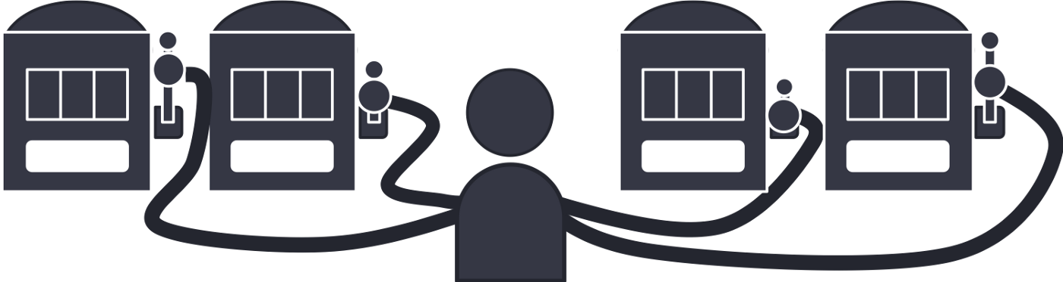
“Hybrid”: Bandit Model Selection

Slide 14
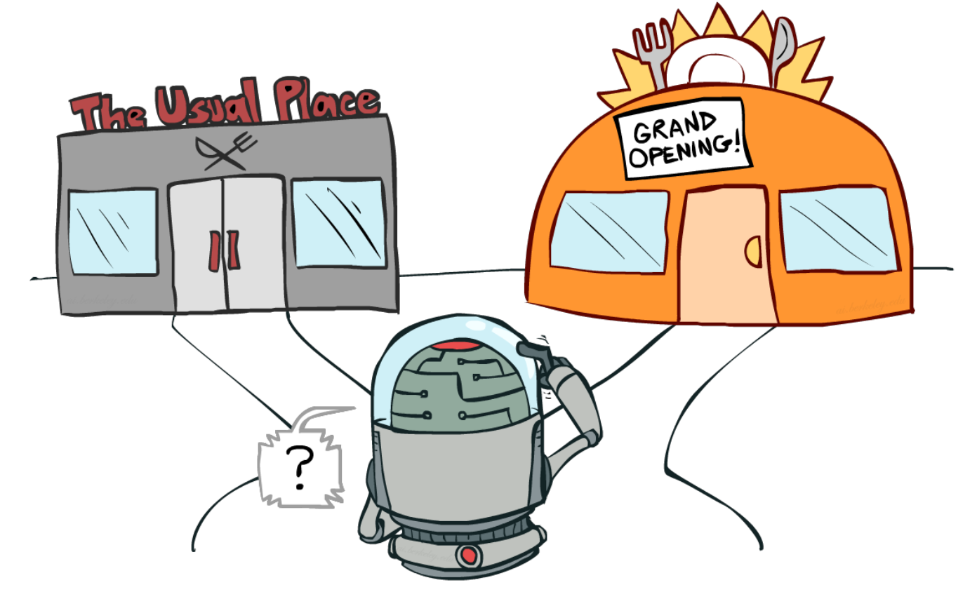
Exploration vs Exploitation

Slide 15
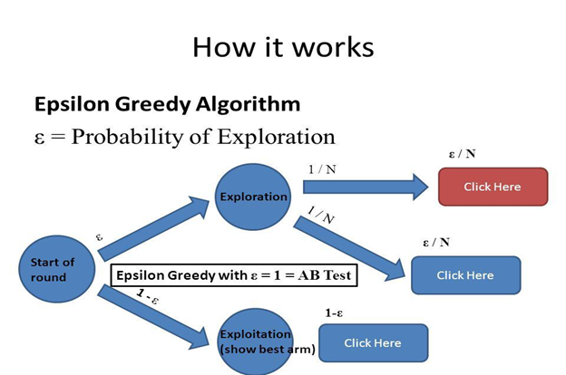
Strategies: Epsilon-greedy/decreasing

Slide 16

Strategies: UCB1

Slide 17
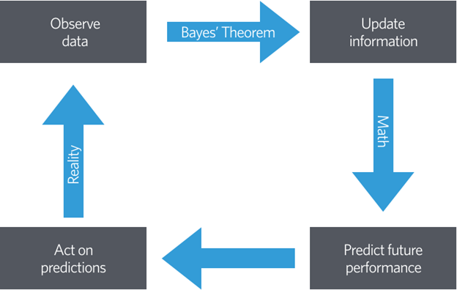
Strategies: Thompson Sampling

Slide 18
Some examples
FIESTA: Fast IdEntification of State-of-The-Art models using adaptive bandit algorithms
Use a strategy similar to sequential halving for identifying among “state of the art” models for NLP tasks.
Source code in Python here.
A Multi-Armed Bandit Model Selection for Cold-Start User Recommendation
Model Selection in Contextual Stochastic Bandit Problems
Focus on advertising/ecommerce: when to use what kind of information to recommend something or show an ad to a user?
More on Bandit Algorithms here.

Slide 19
Tools and Services
Azure Personalizer
https://docs.microsoft.com/en-us/azure/cognitive-services/personalizer/
Seldon Core
https://docs.seldon.io/projects/seldon-core/en/latest/analytics/routers.html

Slide 20
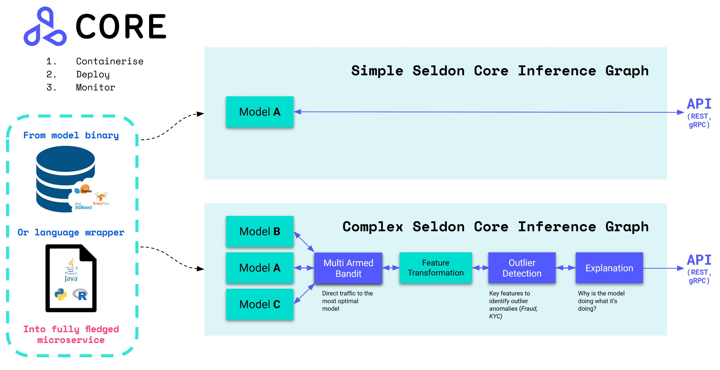
Seldon Core
Notes:
Productionize your models in Kubernetes (via Helm or Kustomize)
Easy way to containerise ML models using our language wrappers or pre-packaged inference servers.
Out of the box endpoints which can be tested through Swagger UI, Seldon Python Client or Curl / GRPCurl
Cloud agnostic and tested on AWS EKS, Azure AKS, Google GKE, Alicloud, Digital Ocean and Openshift.
Powerful and rich inference graphs made out of predictors, transformers, routers, combiners, and more.
A standardised serving layer across models from heterogeneous toolkits and languages.
Advanced and customisable metrics with integration to Prometheus and Grafana.
Full auditability through model input-output request logging integration with Elasticsearch.
Microservice tracing through integration to Jaeger for insights on latency across microservice hops.

Slide 21
Machine Learning Ops (MLOps)

Slide 22
What is MLOps?
Commitment to automation and monitoring at all steps of ML system construction:
Development
Integration
Testing
Releasing
Deployment
Infrastructure management.

Slide 23
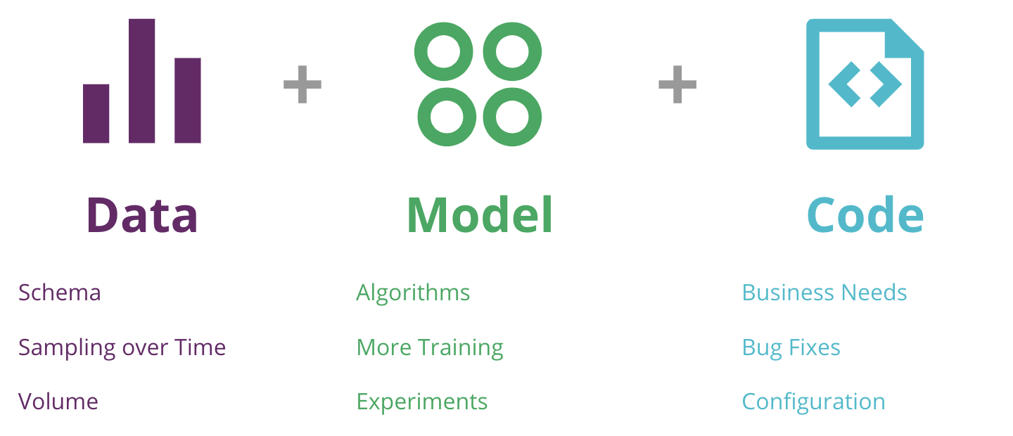
The 3 axis of a ML application
https://martinfowler.com/articles/cd4ml.html

Slide 24
DevOps vs MLOps
DevOps also aims for more automation and reducing development cycles, mainly through two concepts:
Continuous Integration (CI):
Merging all developers’ work several times a day.
Keep a common repository.
Automate code builds and testing.
Continuous Delivery (CD):
Produce software in short cycles, ensuring that the software can be released virtually at any time.
Use of microservices architecture.

Slide 25
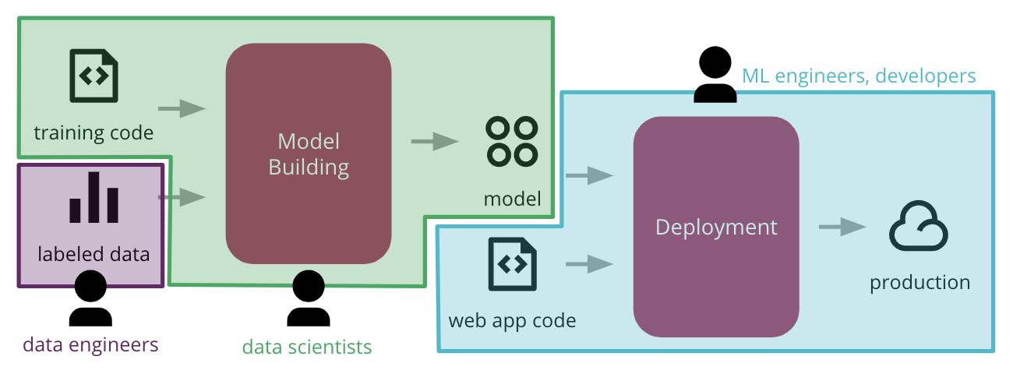
DevOps vs MLOps (cont.)
What makes ML hard for DevOps?
Diverse skillset of team members.
ML is, by definition, experimental. And experiments can be slow.
Testing is more convoluted, as model metrics matter as much as software quality.
Reproducibility is an issue: different tools used by different teams make it hard to use end-to-end.
https://martinfowler.com/articles/cd4ml.html

Slide 26
MLOps
CI:
Testing and validating code and components
But also testing and validating data, data schemas, and models.
CD:
is no longer about a single software package or a service
but a system (an ML training pipeline + a model prediction service).
Continuous Training (CT) emerges as a new property
Automatically retraining and serving the models.

Slide 27
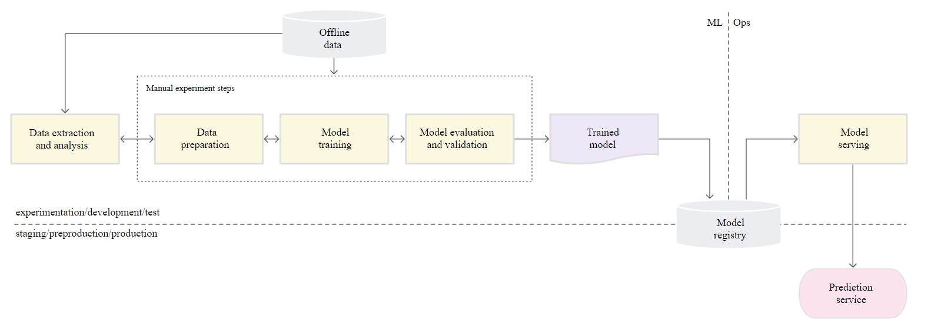
Manual ML step

Slide 28
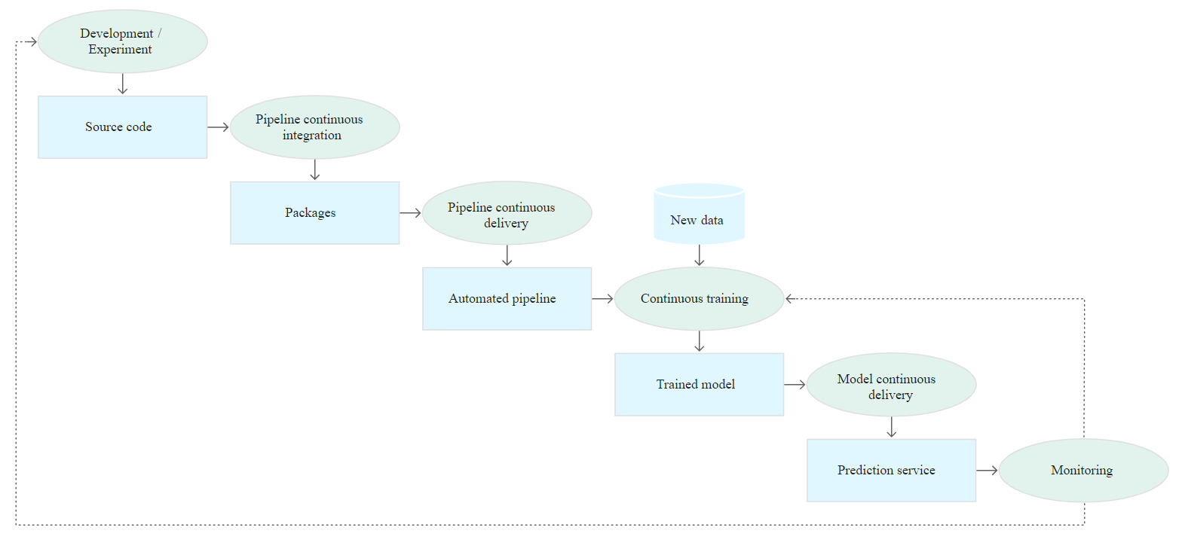
ML CI/CD Pipeline
Notes:
Development and experimentation: You iteratively try out new ML algorithms and new modeling where the experiment steps are orchestrated. The output of this stage is the source code of the ML pipeline steps that are then pushed to a source repository.
Pipeline continuous integration: You build source code and run various tests. The outputs of this stage are pipeline components (packages, executables, and artifacts) to be deployed in a later stage.
Pipeline continuous delivery: You deploy the artifacts produced by the CI stage to the target environment. The output of this stage is a deployed pipeline with the new implementation of the model.
Automated triggering: The pipeline is automatically executed in production based on a schedule or in response to a trigger. The output of this stage is a trained model that is pushed to the model registry.
Model continuous delivery: You serve the trained model as a prediction service for the predictions. The output of this stage is a deployed model prediction service.
Monitoring: You collect statistics on the model performance based on live data. The output of this stage is a trigger to execute the pipeline or to execute a new experiment cycle.
Development and experimentation: You iteratively try out new ML algorithms and new modeling where the experiment steps are orchestrated. The output of this stage is the source code of the ML pipeline steps that are then pushed to a source repository.
Pipeline continuous integration: You build source code and run various tests. The outputs of this stage are pipeline components (packages, executables, and artifacts) to be deployed in a later stage.
Pipeline continuous delivery: You deploy the artifacts produced by the CI stage to the target environment. The output of this stage is a deployed pipeline with the new implementation of the model.
Automated triggering: The pipeline is automatically executed in production based on a schedule or in response to a trigger. The output of this stage is a trained model that is pushed to the model registry.
Model continuous delivery: You serve the trained model as a prediction service for the predictions. The output of this stage is a deployed model prediction service.
Monitoring: You collect statistics on the model performance based on live data. The output of this stage is a trigger to execute the pipeline or to execute a new experiment cycle.

Slide 29
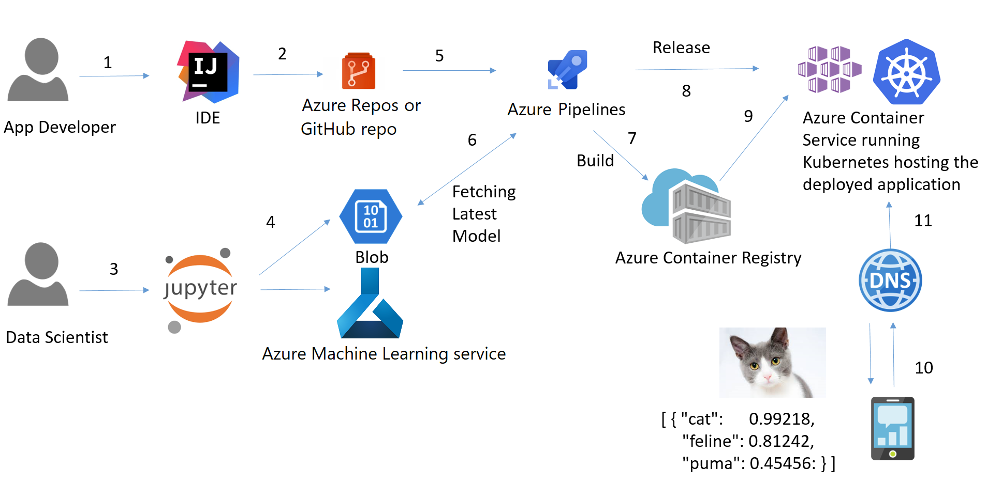
Example: Azure CI/CD pipeline for ML
https://github.com/Azure/DevOps-For-AI-Apps/blob/jainr-refactor/Tutorial.md

Slide 30
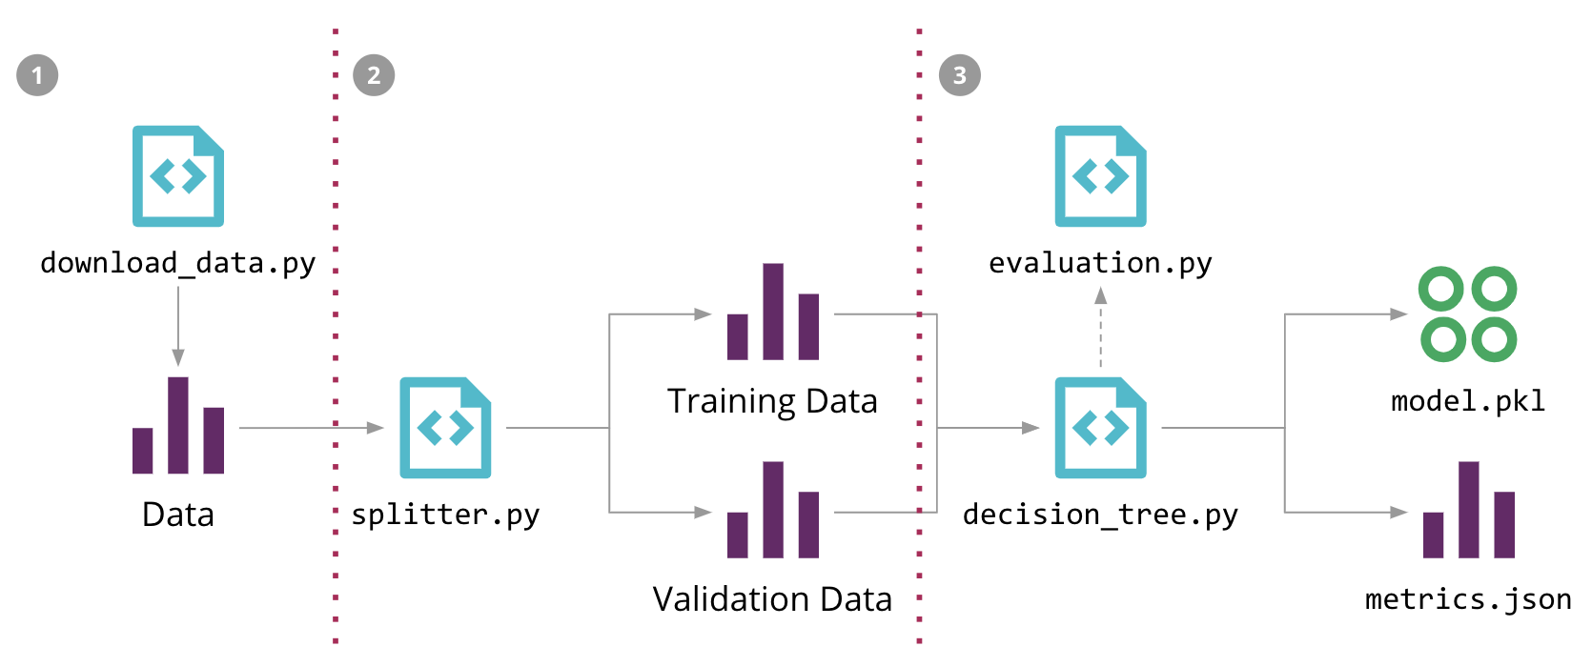
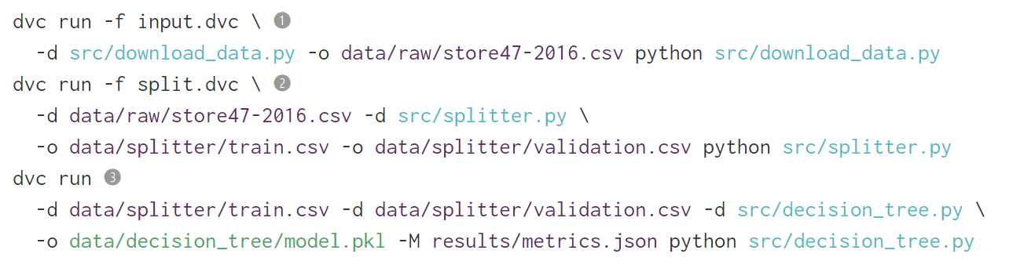
Example: CD4ML
https://martinfowler.com/articles/cd4ml.html#ReproducibleModelTraining
Notes:
DVC is a tool that has similar semantics to Git, but solves a few ML-specific problems
- it has multiple backend plugins to fetch and store large files on an external storage outside of the source control repository;
- it can keep track of those files' versions, allowing us to retrain our models when the data changes;
- it keeps track of the dependency graph and commands used to execute the ML pipeline, allowing the process to be reproduced in other environments;
- it can integrate with Git branches to allow multiple experiments to co-exist;

Slide 31
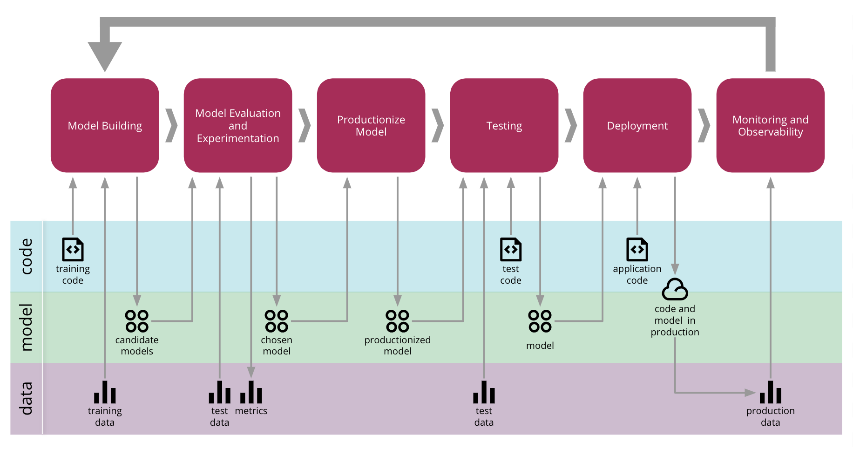
End-to-End CD for ML

Slide 32
Other Considerations

Slide 33
Fairness and Bias
Training data and validation are performed on historical data, which has some inherent bias.
Once the model is deployed, the impact on the users of your model will affect the type of training data.
Example:
An over-performing model that blocks transactions will eventually not collect enough “bad” samples.
A sales forecasting model that underestimates demand will not provide enough products to sell, hence over time the forecast will be underestimated.

Slide 34
3 rules for useful ML models
Business Impact first:
“Accuracy” or other ML metrics are fine, but it is important to define a measurable business metric, and then define the ML metric that is more closely correlated to it.
Focus on a MVP:
Start with a simple and interpretable model, avoid premature optimization.
Productionize Early:
Create reusable components as much as possible, avoid hard-coding stuff.

Slide 35
Wrap-up
Eventually evolving an intelligent system that trains, improves and chooses models is the ultimate AutoML goal.
We might see in the (near) future more usage of reinforcement learning or online learning techniques in production.
For the time being, best-practices from software engineering will have to guide us:
Version Control
Repeatable Experiments
Automated training/testing
Continuous Delivery

Slide 36
Дякую за увагу!

